Slide 1
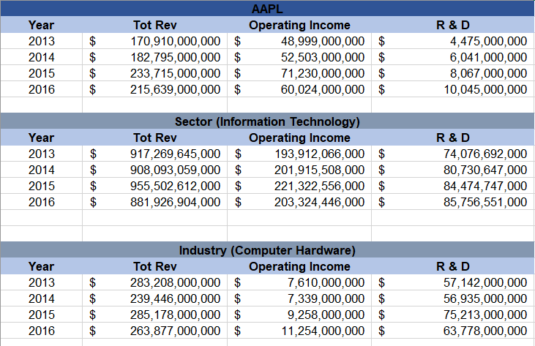
Apple performance from 2013-2016 (AAPL)
Apple performance compared to its respective Sector and Industry

Slide 2
Apple’s revenue has been growing on a 9% average year over year (between 2012-2016)
While Apple’s revenue has been pretty stable year over year, the total for its industry and sector haven’t.

Slide 3
As you can see from this chart Apple controls almost 25% of the whole Information Technology sector!
It’s even more impressive when you see that it controls almost have of the computer-hardware industry

Slide 4
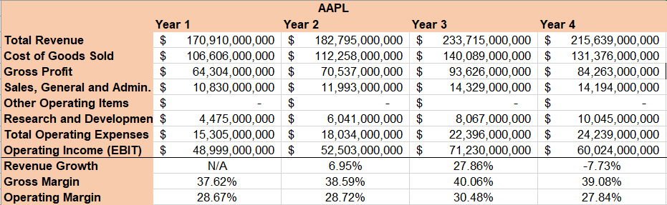
The following is the PnL statement for Apple

Slide 5
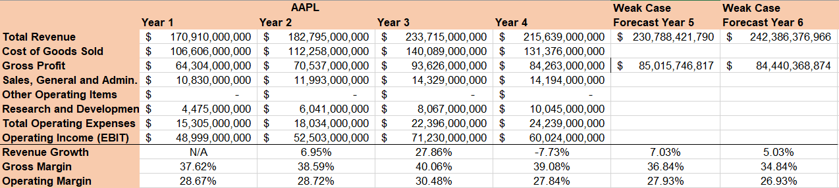
And with the next two years forecasted:

Slide 6
As you can see Apple only spends 1.4B towards R&D compared to its industry average of 4.43B, yet it outperforms most companies in its own industry

Slide 7
Interestingly enough the range for Apple’s operating income is 22.2B compared to its industry average of just 3.9B, this means that their yearly operating income is very volatile and unpredictable.
But it’s also because they’ve been growing so fast and their income is much higher than most companies in its Industry. (50B VS 10B for its industry average)

Slide 8
Apple’s Standard Deviation for its Operating Income is also pretty high compared to its industry average, which means its less predictable and more spread out.

Slide 9
Summary
Apple is outperforming its counterparts in both its industry, and sector.
It’s also increasing the gross margin, and keeping the operating margin relatively stable.
It’s also good to see that even tho they’ve had a very successful performance in the last decade they are still increasing their budget on R&D.

